Slide 1
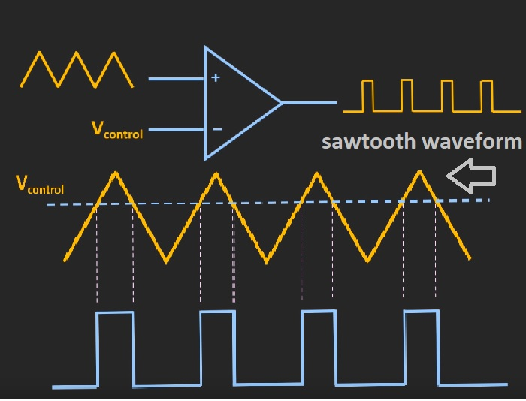
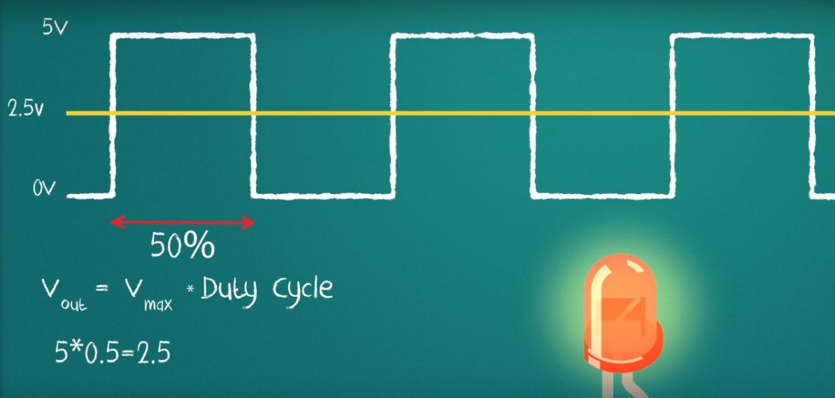
Pulse Width Modulation (PWM)

Slide 2
Introduction
Pulse Width Modulation (PWM) has many application in digital communication and power electronics:
  Intensity control of street lights, speed control of dc motor
  PWM is used to generate analog signal from digital signals, digital to analog converter.

Slide 3
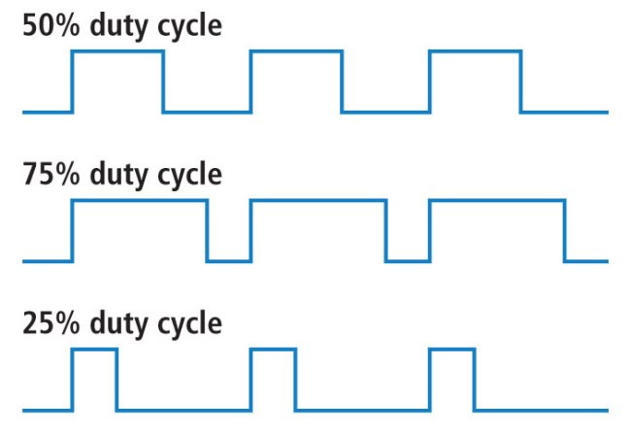
Frequency and Duty Cycle
All waves have the same frequency but different duty-cycle

Slide 4

Example
50% duty cycle generates 2.5V at the output

Slide 5
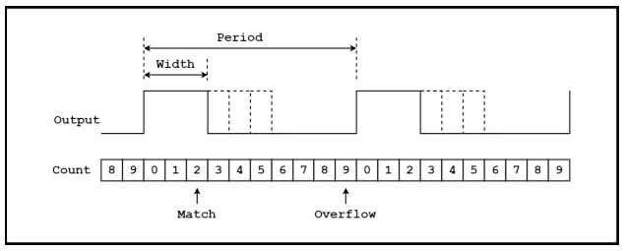
PWM generator in MCU
Software based programming
Hardware based timer counter

Slide 6
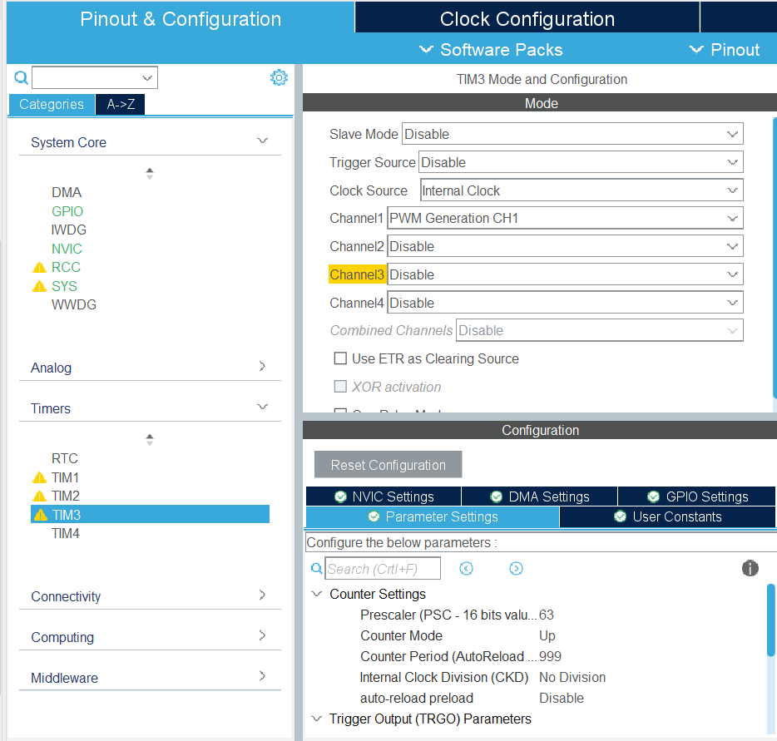
PWM Configuration in STM32
TIM3 – Channel 1
Frequency = 1kHz
  64MHz → 1Mhz → 1kHz
PA6 is the output of TIM3-CH1

Slide 7
PWM Programming in STM32
HAL_TIM_PWM_Start(&htim3, TIM_CHANNEL_1);
while (1)
{
__HAL_TIM_SetCompare (&htim3,TIM_CHANNEL_1,10);
HAL_Delay(1000);
__HAL_TIM_SetCompare (&htim3,TIM_CHANNEL_1,100);
HAL_Delay(1000);
}

